Slide 1

7th Grade Math
Unit 1, Lesson 6 Writing and Solving One-Step Equations in Real-World Contexts Volume 1, pg. 30

Slide 2


Benchmarks
MA.6.AR.2.2 Write and solve one-step equations in one variable within a mathematical or real-world context using addition and subtraction, where all terms and solutions are integers.
MA.6.AR.2.3 Write and solve one-step equations in one variable within a mathematical or real-world context using multiplication and division, where all terms and solutions are integers.
volume 1, pg. 30

Slide 3
Integrated Mathematical Thinking and Reasoning Standards
MA.K12.MTR.1.1 Actively participate in effortful learning both individually and collectively.
MA.K12.MTR.4.1 Engage in discussions that reflect on the mathematical thinking of self and others.
MA.K12.MTR.7.1 Apply mathematics to real-world contexts.
volume 1, pg. 30

Slide 4

Learning Target
I can write and solve one-step addition, subtraction, multiplication, and division equations that represent a real-world context.
volume 1, pg. 30

Slide 5

Warm-Up
volume 1, pg. 30

Slide 6
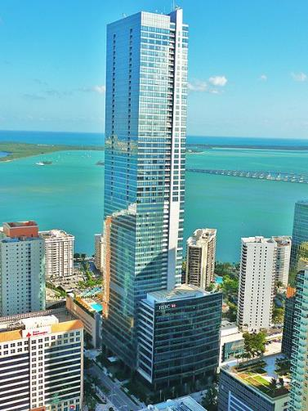
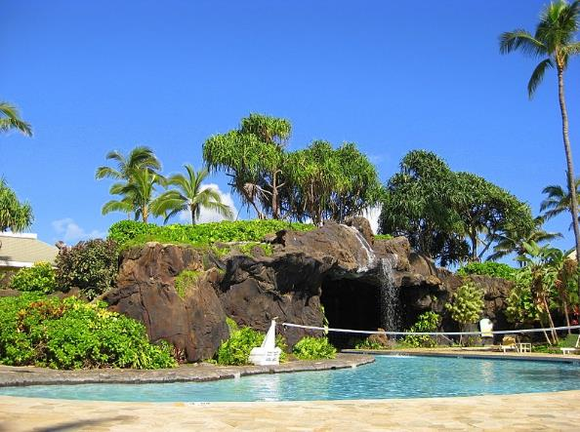
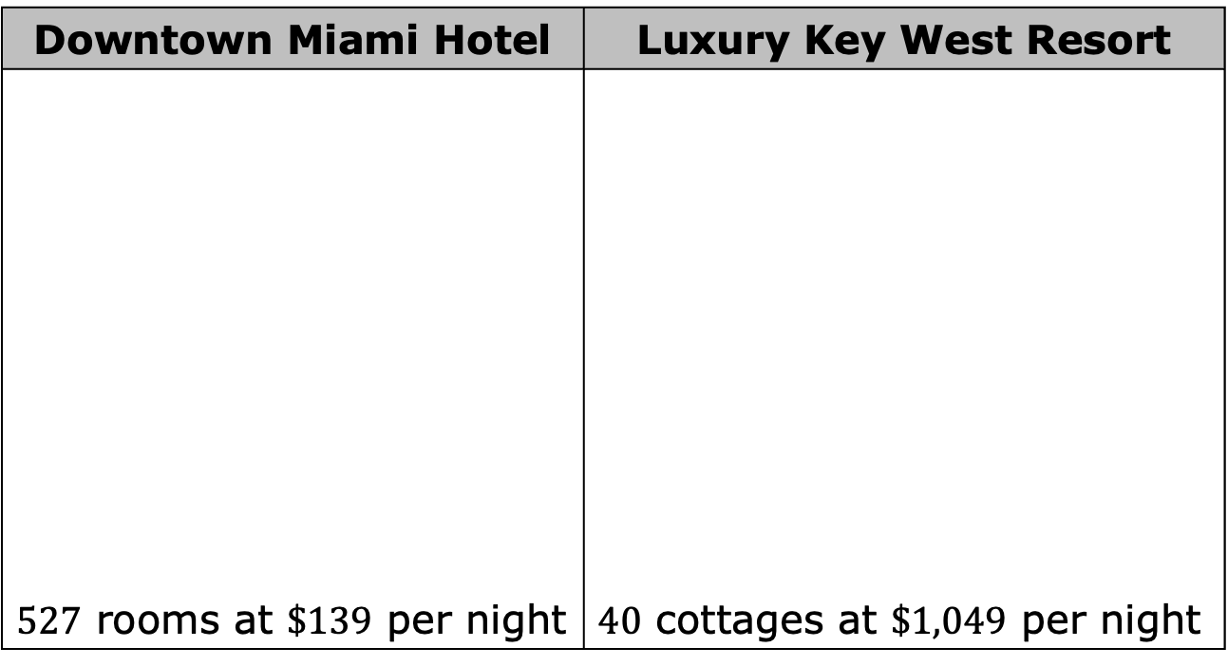
1.6.1 Warm-Up: Would You Rather?
The number of rooms and rate per night at two different Florida hotels are shown.
Downtown Miami Hotel | Luxury Key West Resort
$527$ rooms at $\$139$ per night | $40$ cottages at $\$1,049$ per night
volume 1, pg. 30

Slide 7
From which business would you rather earn the revenue?
Explain your reasoning using mathematics.
volume 1, pg. 30

Slide 8

Collaboration
volume 1, pg. 31

Slide 9

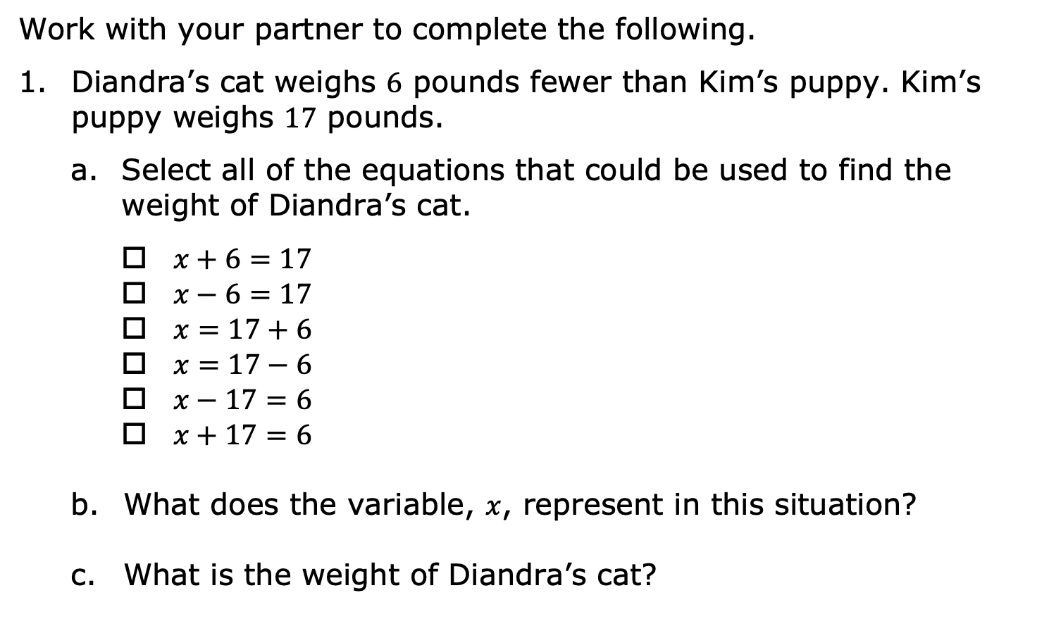
1.6.2 Collaboration: Writing and Solving Equations in Real-World Context
Work with your partner to complete the following.
Diandra’s cat weighs $6$ pounds fewer than Kim’s puppy. Kim’s puppy weighs $17$ pounds.
Select all of the equations that could be used to find the weight of Diandra’s cat.
$x+6=17$
$x−6=17$
$x=17+6$
$x=17−6$
$x−17=6$
$x+17=6$
What does the variable, $x$, represent in this situation?
What is the weight of Diandra’s cat?
volume 1, pg. 31

Slide 10
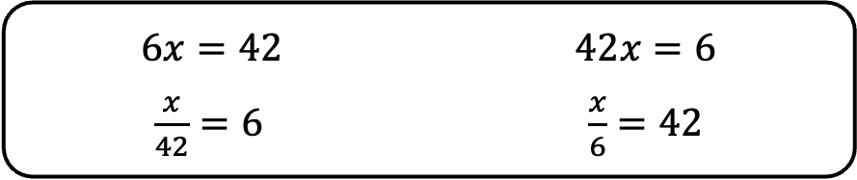
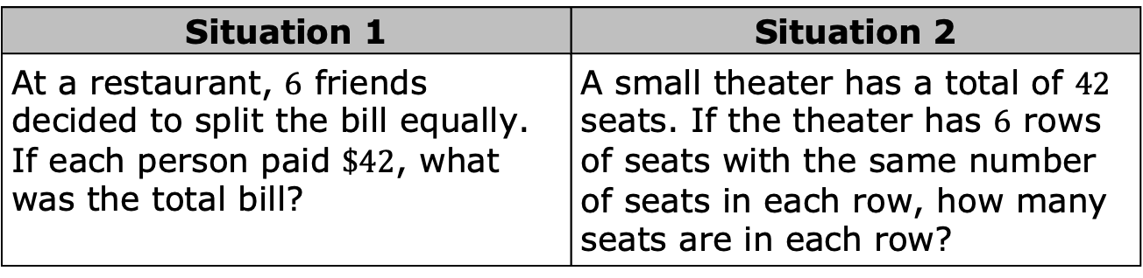

Four equations are shown.
Discuss with your partner which of the equations correctly represents each situation below, where $x$ represents the unknown quantity.
$6x=42$ $42x=6$
$\frac{x}{42}=6$ $\frac{x}{6}=42$
Situation 1 | Situation 2
At a restaurant, $6$ friends decided to split the bill equally. If each person paid $\$42$, what was the total bill? | A small theater has a total of $42$ seats. If the theater has $6$ rows of seats with the same number of seats in each row, how many seats are in each row?
volume 1, pg. 31

Slide 11
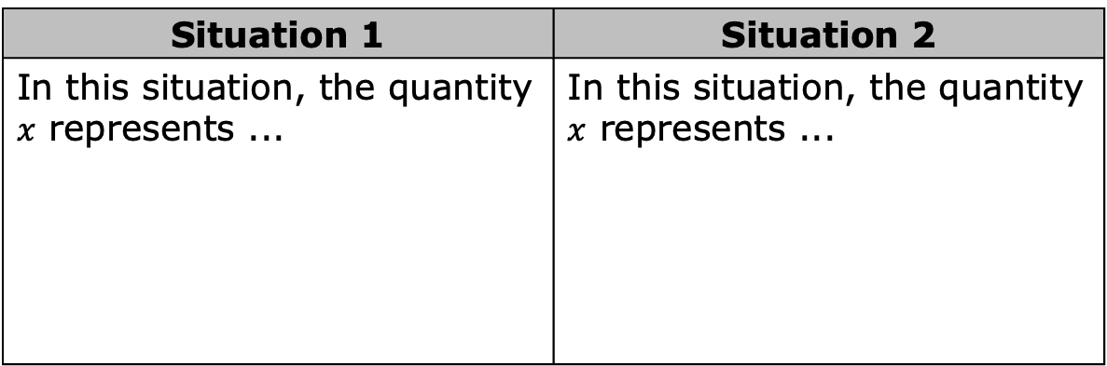

Write the matching equation in the space provided.
What does $x$ represent in each equation?
Situation 1 | Situation 2
Equation: | Equation:
Situation 1 | Situation 2
In this situation, the quantity $x$ represents ... | In this situation, the quantity $x$ represents ...
volume 1, pg. 31

Slide 12

Guided Practice
volume 1, pg. 32

Slide 13

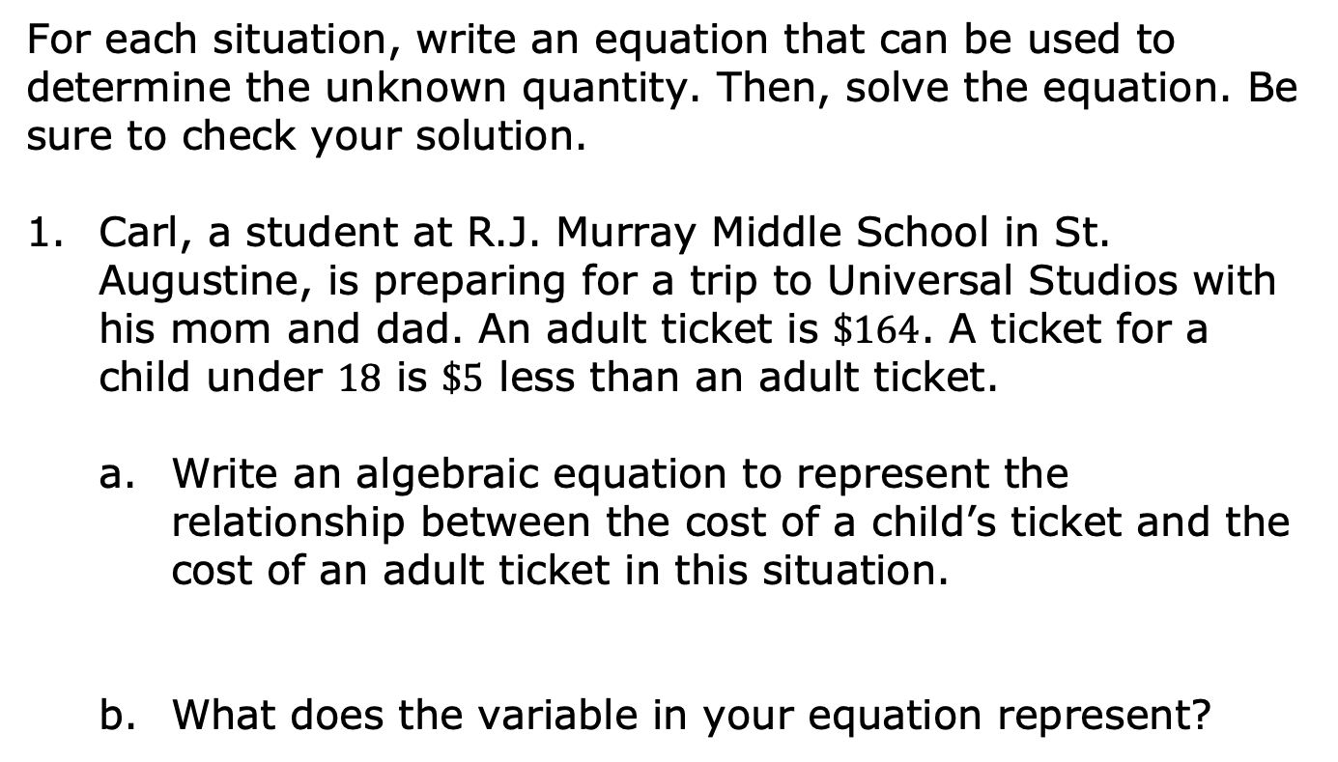
1.6.3 Guided Practice: Writing and Solving Real-World Problems with One-Step Equations
For each situation, write an equation that can be used to determine the unknown quantity. Then, solve the equation. Be sure to check your solution.
Carl, a student at R.J. Murray Middle School in St. Augustine, is preparing for a trip to Universal Studios with his mom and dad. An adult ticket is $\$164$. A ticket for a child under $18$ is $\$5$ less than an adult ticket.
Write an algebraic equation to represent the relationship between the cost of a child’s ticket and the cost of an adult ticket in this situation.
What does the variable in your equation represent?
volume 1, pg. 32

Slide 14
Solve the equation.
What was the cost of Carl’s ticket?
volume 1, pg. 32

Slide 15
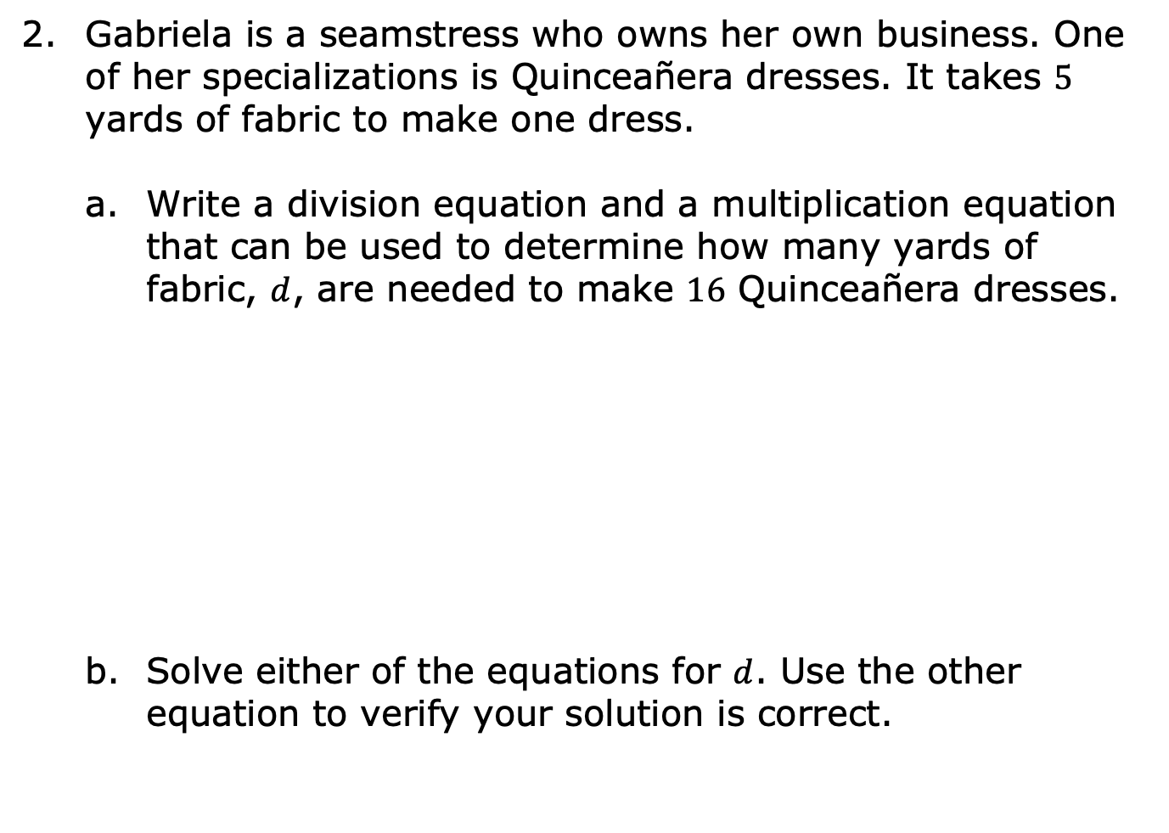
Gabriela is a seamstress who owns her own business. One of her specializations is Quinceañera dresses. It takes $5$ yards of fabric to make one dress.
Write a division equation and a multiplication equation that can be used to determine how many yards of fabric, $d$, are needed to make $16$ Quinceañera dresses.
Solve either of the equations for $d$. Use the other equation to verify your solution is correct.
Division Equation | Multiplication Equation
volume 1, pg. 32

Slide 16
Collaboration
volume 1, pg. 33

Slide 17
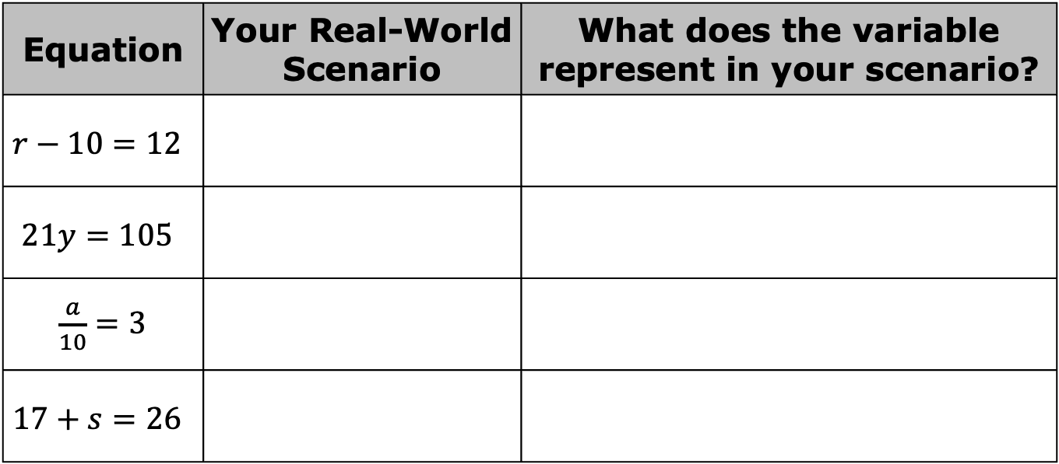
1.6.4 Collaboration: Writing Real-World Scenarios to Represent Algebraic Equations
For each equation, create a real-world problem that the algebraic equation could represent.
Equation | Your Real-World Scenario | What does the variable represent in your scenario?
$$r−10=12$$
$$21y=105$$
$\frac{a}{10}=3$
$$17+s=26$$
volume 1, pg. 33

Slide 18
Pick two equations from the table and compare your scenarios and solutions with your partner. Use them to complete the table below.
Equation | Your Partner’s Scenario | Does the equation represent your partner’s scenario? | Similarities between scenarios for the equation
 |  | Yes No
 |  | Yes No
volume 1, pg. 33

Slide 19

Wrap-Up
volume 1, pg. 34

Slide 20
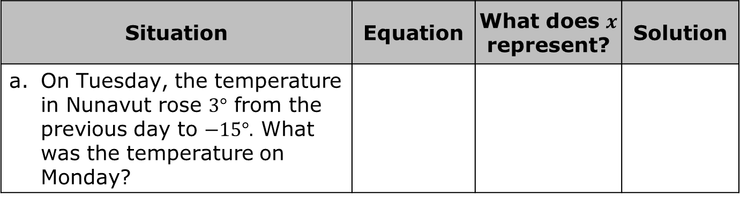
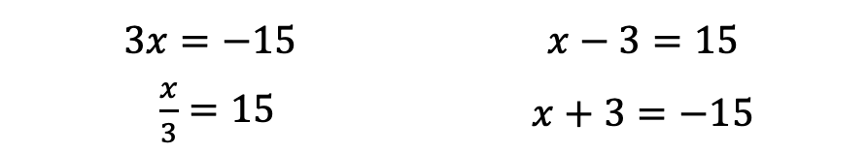
1.6.5 Wrap-Up: Ticket Out the Door
Four equations are shown. Match an equation to each situation it represents. Then, complete the table. Not all equations will be used.
$$3x=−15$$ | $$x−3=15$$
$\frac{x}{3}=15$ | $$x+3=−15$$
Situation | Equation | What does $x$ represent? | Solution
On Tuesday, the temperature in Nunavut rose $3°$ from the previous day to $−15°.$ What was the temperature on Monday?
volume 1, pg. 34

Slide 21
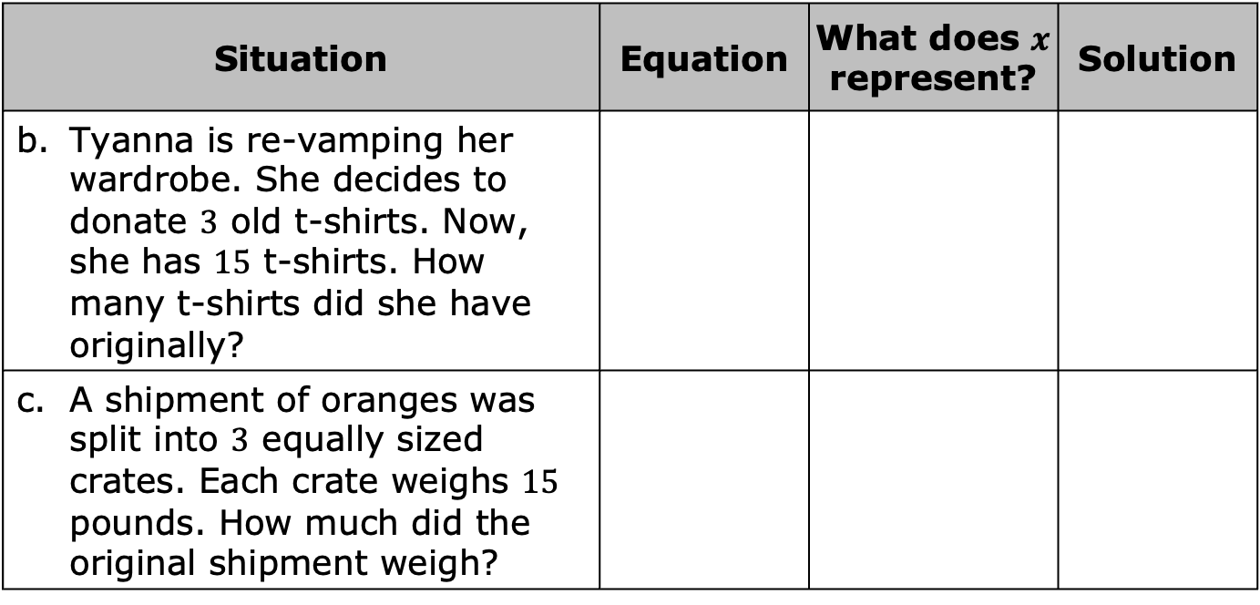
Situation | Equation | What does $x$ represent? | Solution
Tyanna is re-vamping her wardrobe. She decides to donate $3$ old t-shirts. Now, she has $15$ t-shirts. How many t-shirts did she have originally?
A shipment of oranges was split into $3$ equally sized crates. Each crate weighs $15$ pounds. How much did the original shipment weigh?
volume 1, pg. 34

